Slide 1
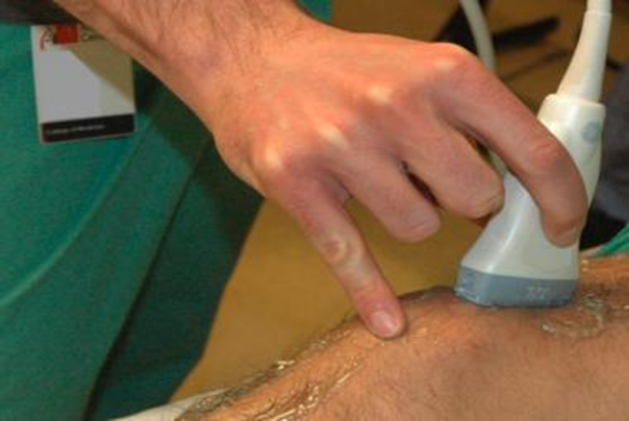
Ultrasound machine
principles of operation
  function / use / scientific principles
construction
  components / system diagram
  inputs/outputs
troubleshooting
  identifying common faults / replacing components / rectifying faults
safety considerations
  user and patient safety/ electrical safety
performance monitoring
  calibration / quality assurance and control
18.6.7 Maintain an ultrasound machine
Unit C18.6 Maintaining Medical Imaging Equipment
Module 279 19 C Medical Instrumentation II
©
dr. Chris R. Mol, BME, NORTEC, 2016

Slide 2
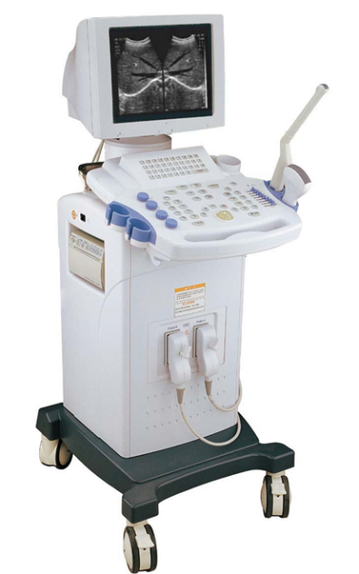
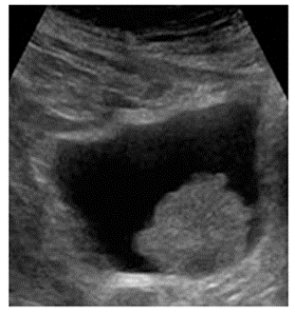
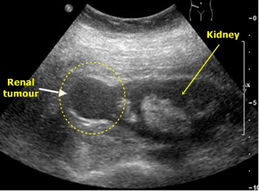
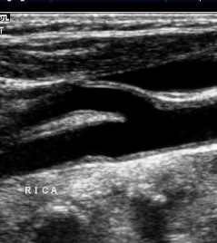
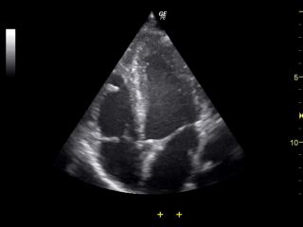
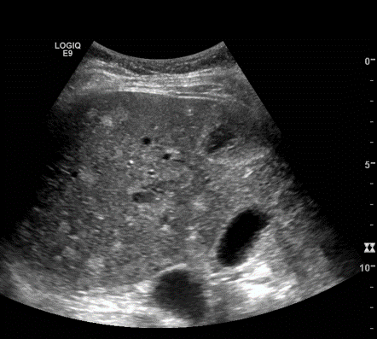
Ultrasound applications
Ultrasound is routinely applied in many parts of the body and for many applications, including
gynaecology and neonatology
cardiology, to detect ventricular size and heart valve anomalies
neurology for blood flow assessment
nephrology (kidney, bladder)
Ultrasound systems can deliver static or dynamic images (e.g. heart valves)
bladder with
cancer
kidney with cancer
blood vessels
heart valves
liver with cirrhosis
(too much alcohol)
©
Medical Imaging
dr. Chris R. Mol, BME, NORTEC, 2016

Slide 3
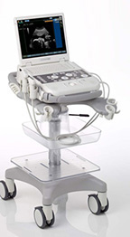
Use
Compared to other prominent methods of medical imaging, ultrasound has several (dis-)advantages.
Advantages include:
  It provides images in real-time (still and video),
  it is portable and can be brought to the bedside,
  it is substantially lower in cost,
  it does not use harmful ionizing radiation.
Drawbacks include:
  various limits on its field of view including
    patient cooperation and physique (obese),
    difficulty imaging structures behind bone and air,
  and its dependence on a skilled operator.
©
Ultrasound Principles
dr. Chris R. Mol, BME, NORTEC, 2016

Slide 4
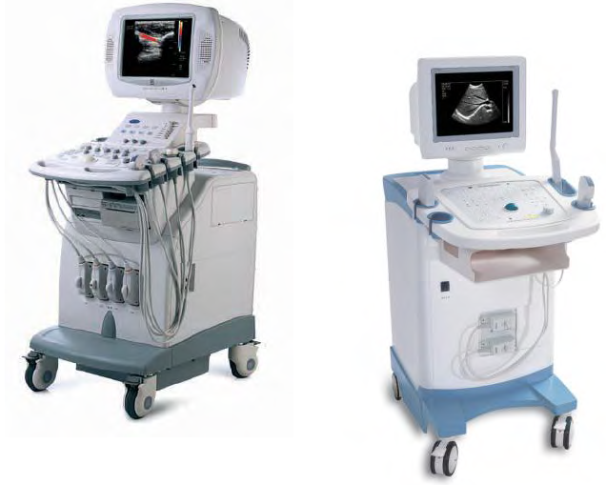
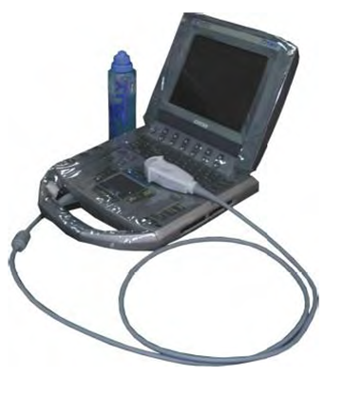
Ultrasound Systems
A large variety of ultrasound systems is on the market.
Specialized ultrasound systems are available per application domain, e.g. cardiovascular, gynaecological.
General purpose ultrasound systems may differ in:
different transducers
color Doppler ultrasound
3D-imaging capability
portability
post processing functions
networking capability
….
Portable model
High end model
Black & white model
Market prices of ultrasound systems are in the range of USD 20,000 - 300,000, depending on system configuration.
©
Ultrasound System
dr. Chris R. Mol, BME, NORTEC, 2016

Slide 5
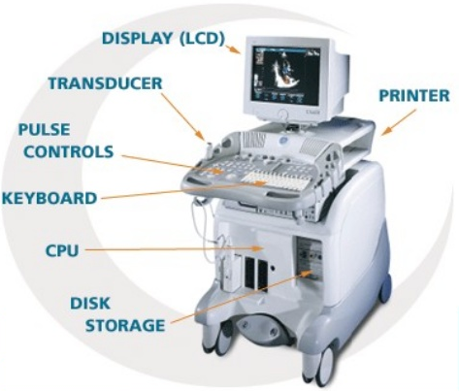
Construction
©
Ultrasound System
dr. Chris R. Mol, BME, NORTEC, 2016

Slide 6
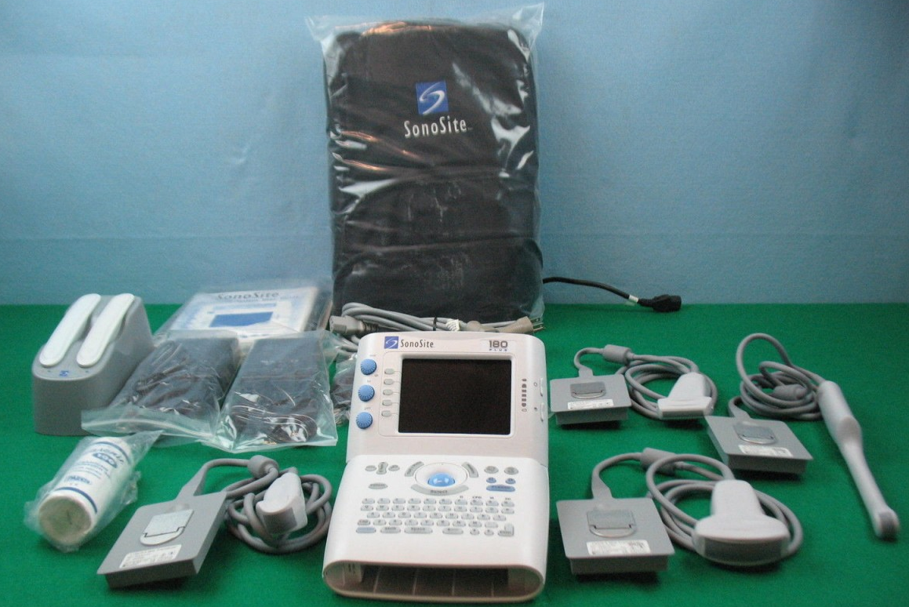
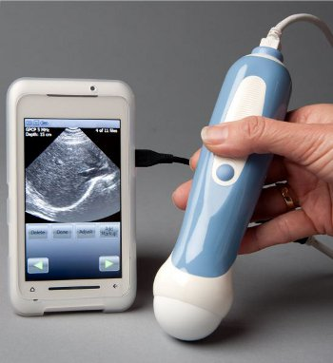
Portable ultrasound system (examples)
portable ultrasound system with four transducers
ultrasound system on smart phone
©
Ultrasound System
dr. Chris R. Mol, BME, NORTEC, 2016

Slide 7
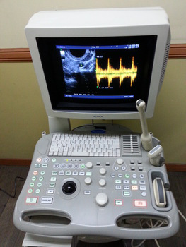
User Interface (example)
The user interfaces are operated partly via screen menus (graphic user interface or GUI), partly via direct buttons - for frequently used functions.
A (black) tracker ball is used as pointing device, because of the lack of a flat surface for mouse operation.
3 ultrasound transducers for different applications are visible on the right side.
©
Ultrasound System
dr. Chris R. Mol, BME, NORTEC, 2016

Slide 8
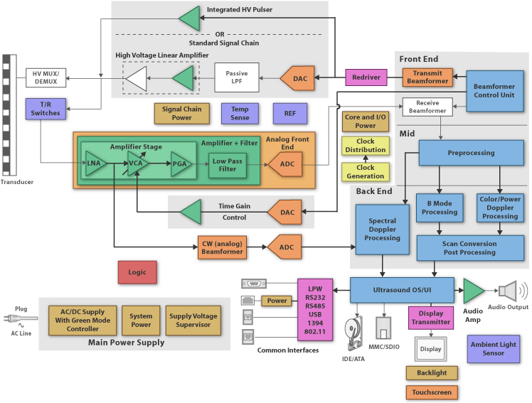
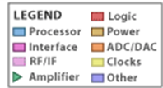
Construction
Typical components
a beam former,
a central processing unit,
a user interface (e.g. keyboard, control panel, mouse),
several transducers,
one or more displays,
a recording device,
a power system.
©
Ultrasound System
dr. Chris R. Mol, BME, NORTEC, 2016

Slide 9
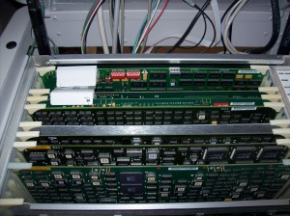
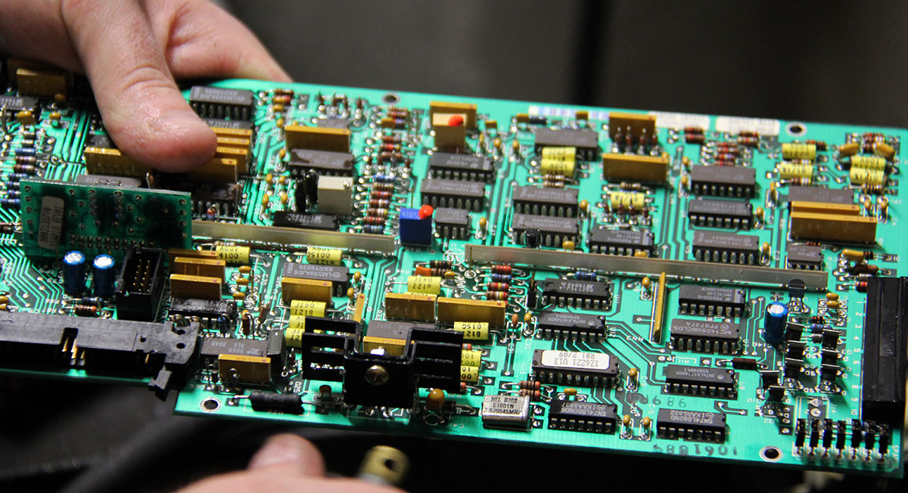
Construction
A high end ultrasound system contains a lot of electronics. Repair cannot be undertaken without guidance of a service manual. The most common problem, next to user and power issues, is poor connections of the PCBs in their connectors/slots.
©
Ultrasound System
dr. Chris R. Mol, BME, NORTEC, 2016

Slide 10


Ultrasound Transmitter and Receiver
Electrical design diagrams are interesting for designers, but rarely for general BMET equipment maintainers.
transmitter
When an ultrasound system requires corrective maintenance, the BMET checks for the common mistakes (see later on) as well as for broken wires, connectors that make poor contacts (cleaning!), power levels, etc. You can try to exchange a visibly burnt component (?).
If that does not bring improvement, the service manual instructions need to be followed precisely to identify problems such as broken spare parts.
receiver
If this fails, a service engineer with specialized (manufacturers) training needs to become involved.
©
Ultrasound System
dr. Chris R. Mol, BME, NORTEC, 2016

Slide 11
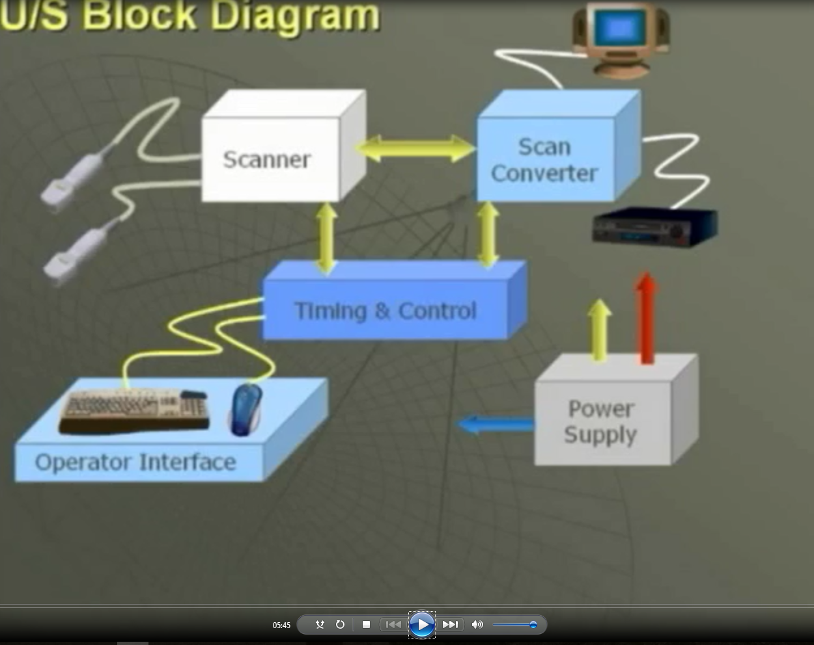
Ultrasound Transmitter and Receiver
Watch:
DVD Ultrasound #5:
Quality Assurance and Block Diagrams
of PartSource DVD set.
©
Ultrasound System
dr. Chris R. Mol, BME, NORTEC, 2016

Slide 12
Corrective Maintenance Highlights
User Error Is enough of the proper ultrasound gel used?
Are the controls set correctly? In particular the contrast and brightness buttons!
Transducer Ensure that the transducer is properly connected and undamaged
The transducer is sensitive to shocks! If there is defective element, you often see a black
line on the image. Transducer cracks cannot be repaired: exchange the transducer.
Gently pull on the cable at different points to see when the image flickers. This is where the cable is broken. If cable/connections are broken: fix by soldering
Dials/buttons If buttons don’t function properly: replace or use anti-corrosive contact spray on dials.
Deteriorating Check mains voltage, check pre-amplifiers, check probe connection, fuses.
image quality Is the machine calibrated correctly?
the CRT (Cathode Ray Tube) monitor may be worn out after a few years. Replace!
A voltage stabilizer may be required in case of varying mains voltage (more than 10%)
Electric contact Poor electric contacts is a major problem in all electronics devices.
©
Ultrasound System
dr. Chris R. Mol, BME, NORTEC, 2016

Slide 13
Preventive Maintenance: Daily & Weekly care
Daily Care:
Clean Wipe dust of exterior and cover
wipe probe with alcohol-free tissue or cloth
Visual Check Check all fittings and accessories are mounted correctly. Check that cables are not twisted and the probe is safely stored.
Function Check If in use that day, run a brief function check before patients arrive.
Weekly Care:
Clean Unplug, clean outside / wheels / rear with damp cloth, dry off
Visual Check Check that mains plug screws are tight. Check that mains cable has no bare wire and is not damaged.
Function Check If machine has not been in use, run and test briefly.
Do not soak the cable with gel!
©
Ultrasound System
dr. Chris R. Mol, BME, NORTEC, 2016

Slide 14
Preventive Maintenance Checklist: BMET
Preventive maintenance (BMET, every six months):
Clean outside (if necessary)
Visual Check Check if all accessories are mounted correctly, incl. strain reliefs.
Check cables, power & connections.
Open system and perform visual check inside the system. Clean.
Grease & filters grease wheels, replace air filters, ….
Function Check Check imaging quality with
different transducers
Calibrate system with phantoms
Safety Check Check electrical safety
This is a general preventive maintenance list. Check service documentation for the maintenance procedures specific for the system at hand.
©
Ultrasound System
dr. Chris R. Mol, BME, NORTEC, 2016

Slide 15
Calibration
Calibration is performed by means of phantoms. Different phantoms are used to test different performance features such as lateral and axial resolution, and correctness of distance measurements. Based of the ultrasound image of the phantom, the good performance of the system can be confirmed. Transducers cannot be adjusted with respect to their image accuracy. If the test result is not acceptable, the transducer should be replaced.
The white dots in the image indicate reflectors at these locations in the phantom.
If the reflections do not show up at the correct locations in the image, something is probably wrong with the transducer.
Full calibration requires using a range of phantoms to test different aspects of the equipment.
Follow the instructions in the service manual.
Phantom (example)
Example of ultrasound image of phantom
©
Ultrasound System
dr. Chris R. Mol, BME, NORTEC, 2016

Slide 16
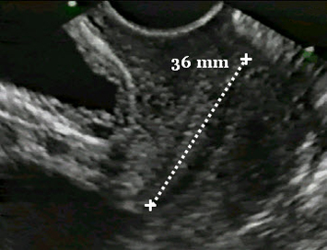
Safety
Ultrasound diagnostic imaging appears to be risk-free when used properly.
Ultrasound transducers should be handled carefully to avoid damage. Electromechanical problems, such as cracks in piezoelectric elements, can alter beam width or sound pulses, thereby affecting resolution. Errors in distance measurements from the images can cause incorrect calculations and thus an incorrect diagnosis.
©
Ultrasound System
dr. Chris R. Mol, BME, NORTEC, 2016

Slide 17

END
The creation of this presentation was supported by a grant from THET:
see https://www.thet.org/

